Slide 1
INTRODUCTION TO ICT Cloud Computing, Fog Computing, Operation System
Ms. Beenish Urooj
week 6

Slide 2
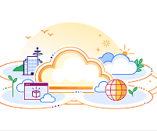
What is Cloud?
In Cloud Computing, the word cloud is used as a metaphor for "the Internet." In other words, we can say cloud is something, which is present at remote location. Well, it is an abstraction of underlying infrastructures involved.

Slide 3


Cloud Computing
Simply put, cloud computing is the delivery of computing services servers, storage, databases, networking, software, and analytics and more- over the Internet(Cloud).
Cloud Computing consists of hardware and software resources made available on the internet as they are managed by the third-party services. These services typically provides access to advanced software applications, high end networks of server computers.
"You don't generate your own electricity. Why generate your own computing?"-Jeff Bezos, Amazon.

Slide 4
Benefits of Cloud Computing
Drive down costs
Accessibility Productivity
Scalability
Access to automatic updates
Business Continuity (Back up & Recovery)
Pay structure

Slide 5

Simple Examples of Cloud Computing
Email: Web-based email services like Gmail and Hotmail deliver a cloud computing service: users can access their email "in the cloud" from any computer with a browser and Internet connection, regardless of what kind of hardware is on that computer. The emails are hosted on Google's and Microsoft's servers, rather than being stored locally on the client computer.
Office Productivity Software: Office 365, Google docs and Zoho office. This software allow you to keep and edit your documents online. By doing so, the documents will be accessible anywhere, and you can share the documents and collaborate on them. Multiple people can work in the same document simultaneously.
Storage: One Drive, Google Drive, iCloud and Drop Box.

Slide 6
Common Cloud Characteristics
On Demand Self Service
Broad network access
Multi-Tenancy (Resource Pooling)
Rapid Elasticity
Measured service

Slide 7
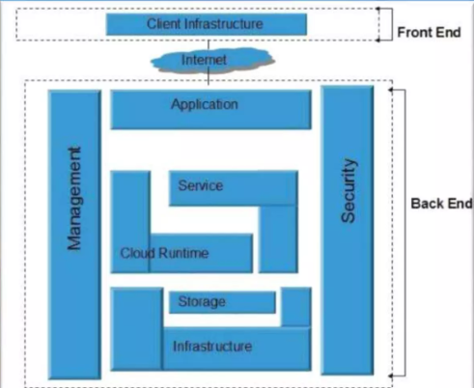
Cloud Architecture

Slide 8
Cloud Models
Deployment Models
Service Models

Slide 9
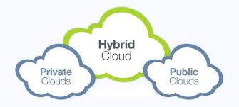
Deployment Models
A cloud deployment model represents a specific type of cloud environment, primarily distinguished by ownership, size, and access.
There are three common cloud deployment models:

Slide 10
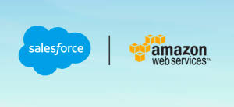
Deployment Models
Public Cloud: Public clouds are owned and operated by a third-party cloud service provider, which deliver their computing resources like servers and storage over the internet.
As the name suggests, Public cloud is open to public. Anyone can access and use it by paying accordingly.

Slide 11
Deployment Models
Private Cloud: The private cloud, in contrast to its public counterpart, isn't available to the public but is built specifically for a single organization to fit its needs. It may be managed internally or by a third-party and be hosted internally or externally.
Hybrid Cloud: A hybrid cloud is a combination of a private cloud combined with the use of public cloud services allowing data and applications to move between private and public clouds. This model gives business greater flexibility and more deployment options

Slide 12
Service Models
In the world of cloud computing, there are three different approaches to cloud-based services:
Infrastructure as a Service (laas)
Platform as a Service (PaaS)
Software as a Service (SaaS)

Slide 13
Service Models
Infrastructure as a service (laas): is a cloud computing offering in which a vendor provides users access to computing resources such as servers, storage, and networking. Organizations use their own platforms and applications within a service provider's infrastructure.
Key features:
Instead of purchasing hardware outright, users pay for laas on demand.
Infrastructure is scalable depending on processing and storage needs.
Saves enterprises the costs of buying and maintaining their own hardware.
Because data is on the cloud, there is no single point of failure.

Slide 14
Service Models
Platform as a service (PaaS): is a cloud computing offering that provides users a cloud environment in which they can develop, manage, and deliver applications. In addition to storage and other computing resources, users can use a suite of prebuilt tools to develop, customize and test their own applications.
Key features
PaaS provides a platform with tools to test, develop, and host applications in the same environment.
Enables organizations to focus on development without having to worry about underlying infrastructure.
Providers manage security, operating systems, server software, and backups.
Facilitates collaborative work even if teams work remotely.

Slide 15
Service Models
Software as a service (SaaS): is a cloud computing offering that provides users with access to a vendor's cloud-based software. Users do not install applications on their local devices. Instead, the applications reside on a remote cloud network accessed through the web or an API. Through the application, users can store and analyze data and collaborate on projects.
Key features:
SaaS vendors provide users with software and applications on a subscription model.
Users do not have to manage, install, or upgrade software; SaaS providers manage this.
Data is secure in the cloud; equipment failure does not result in loss of data.
Use of resources can be scaled depending on service needs.

Slide 16
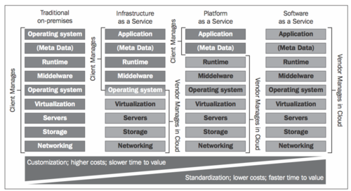
Service Models

Slide 17
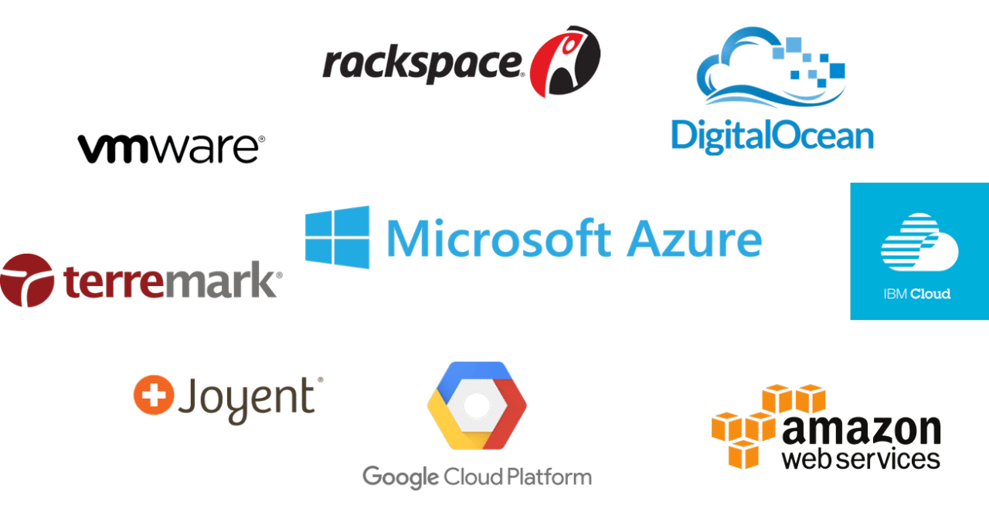
Service Models
IaaS Providers

Slide 18
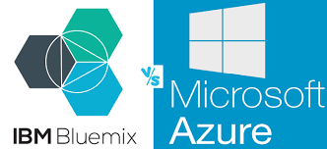
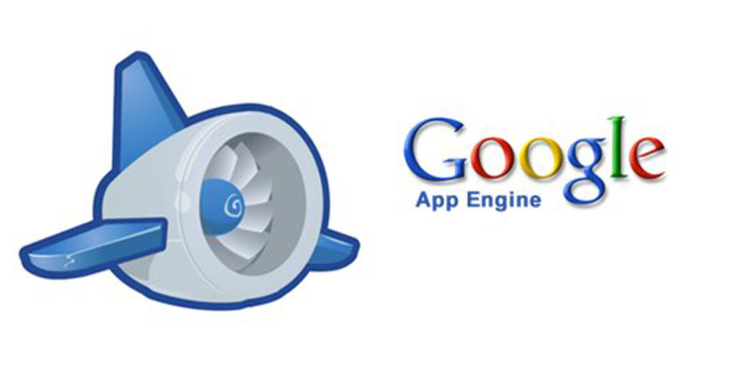
Service Models
PaaS Providers

Slide 19
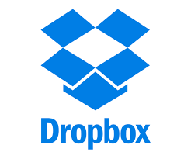
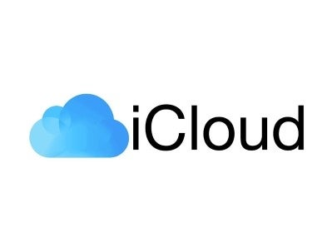
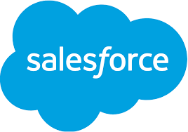
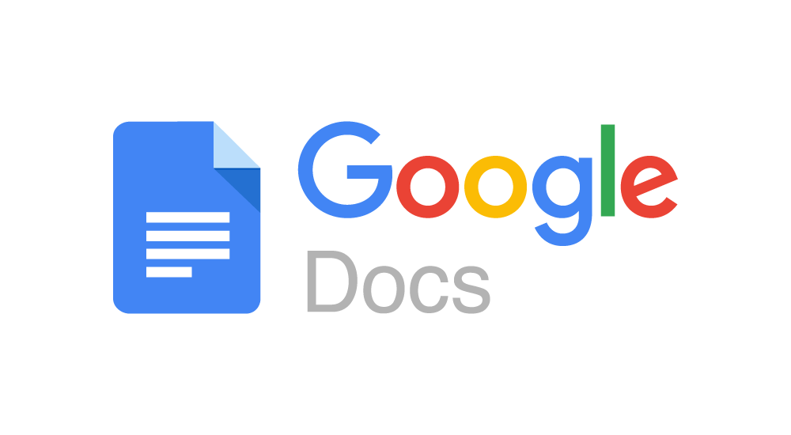
Service Models
SaaS Providers

Slide 20
Risks of Cloud Computing
Security & Privacy
Vendor Lock-In
Platform Lock-in
APIs not portable
Data Lock-in: your data is stuck with a vendor who may legally own it
Tools Lock-In: Tools to manage and develop cloud apps may not work across multiple vendors
Isolation Failure
Management Interface Compromise
Insecure or Incomplete Data Deletion

Slide 21

Fog Computing

Slide 22
Fog Computing
Fog Computing is a paradigm that extends Cloud computing and services to the edge of the network.
Like Cloud, Fog provides data, compute, storage, and application services to end-users.
The motivation of Fog computing lies in a series of real scenarios, such as Smart Grid, smart traffic lights in vehicular networks and software defined networks.
CISCO recently delivered the vision of fog computing to enable applications on billions of connected devices to run directly at the network edge.
Customers can develop, manage and run software applications on Cisco framework of networked devices, including hardened routers and switches. Cisco brings the open-source Linux and network operating system together in a single networked device.

Slide 23
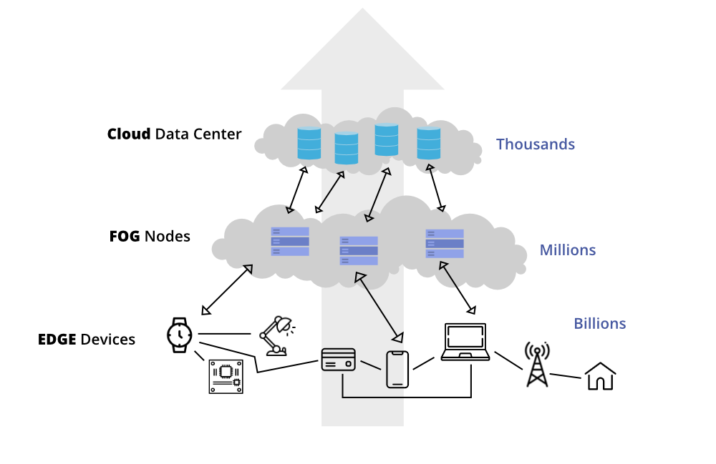
A simple three level hierarchy as shown in above Figure. In this framework, each smart thing is attached to one of Fog devices. Fog devices could be interconnected and each of them is linked to the Cloud

Slide 24
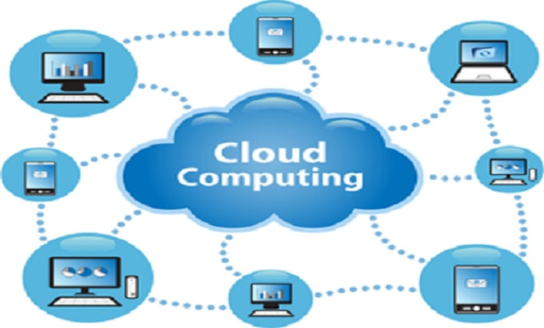
Existing Systems
Cloud computing has provided many opportunities for enterprises by offering their customers a range of computing services. Current "pay-as- you-go" Cloud computing model becomes an efficient alternative to owning and managing private data centers for customers facing Web applications.

Slide 25
Disadvantages
Existing data protection mechanisms such as encryption was failed in securing the data from the attackers.
It does not verify whether the user was authorized or not.
Cloud computing security does not focus on ways of secure the data from unauthorized access.

Slide 26
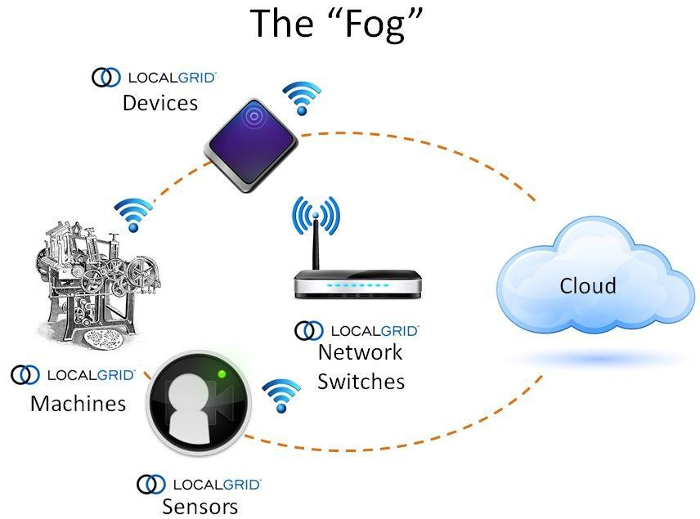
Proposed System
Unlike traditional data centers, Fog devices are geographically distributed platforms, over heterogeneous spanning multiple management domains.
Cisco is interested in innovative proposals that facilitate service mobility across platforms, and technologies that preserve end-user and content security and privacy across domains.

Slide 27
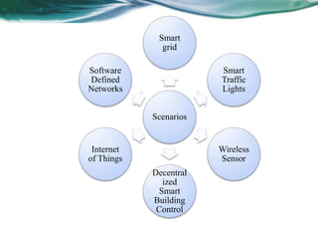
Advantages
Fog can be distinguished from Cloud by its proximity to end-users. The dense geographical distribution and its support for mobility.
It provides low latency, location awareness, and improves quality-of- services (QoS) and real time applications.

Slide 28
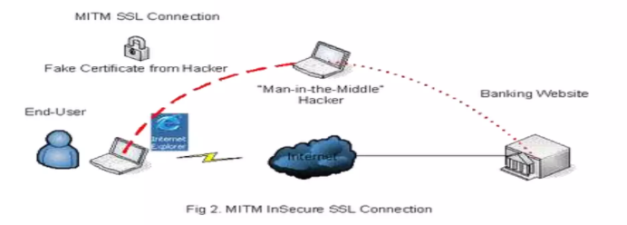
SECURITY ISSUES
EXAMPLE: MAN-IN-THE-MIDDLE-ATTACK
In this subsection, we take man-in-the-middle attack as an example to expose the security problems in Fog computing. In this attack, gateways serving as Fog devices may be compromised or replaced by fake ones.
The main security issues are authentication at different levels of gateways as well as (in case of smart grids) at the smart meters installed in the consumer's home. Each smart meter and smart appliance has an IP address. A malicious user can either tamper with its own smart meter, report false readings, or spoof IP addresses.

Slide 29
Generic Comparison
Cloud computing is generally considered a centralized computing paradigm. In cloud computing, data processing, storage, and application services are provided from a central location—usually large data centers or servers managed by cloud service providers like AWS, Google Cloud, or Microsoft Azure.
Centralized Data Processing: In cloud computing, most of the heavy processing and data management happen in a centralized cloud infrastructure. User devices and systems send data to the cloud, where it is processed and returned back to the user.
Centralized Storage: Data is typically stored in large, geographically distributed data centers. These data centers are owned and managed by cloud providers, giving them control over storage infrastructure.
Centralized Management: Cloud providers manage the infrastructure, including hardware, software, and networking, from a central location. Users and companies access these resources via the internet and rely on centralized control for managing applications and data.
Scalability and Elasticity: While cloud services provide on-demand resources, this scalability is also managed from a central point. The ability to scale up or down based on need comes from the cloud provider’s centrally managed infrastructure.

Slide 30
Contrast with Decentralized Paradigms (Edge/Fog Computing):
Fog computing and edge computing are both decentralized computing paradigms that bring computation and data storage closer to the source of data generation (e.g., IoT devices). However, they differ in how they manage this proximity and how they structure their architecture.
Edge Computing: In edge computing, computation and data processing occur directly on the devices or nodes at the edge of the network, such as sensors, smartphones, or IoT devices. The goal is to reduce latency by processing data as close as possible to where it is generated.
Fog Computing: Fog computing extends the edge concept by providing an intermediate layer of computing between the edge devices and the cloud. This layer, often made up of local or distributed fog nodes, processes, stores, and manages data locally before it is sent to the cloud or back to edge devices.

Slide 31
Contrast with Decentralized Paradigms (Edge/Fog Computing):
Architecture:
Edge Computing: Computation happens at the network’s edge, directly on devices. There’s less need for intermediary devices between the edge and the cloud.
Fog Computing: Adds a layer of intermediary fog nodes (e.g., routers, gateways, local servers) between the edge devices and the cloud. These nodes act as a middle ground, performing data processing, filtering, and aggregation before data is transmitted.
Latency:
Edge Computing: Has the lowest latency since data processing happens at the closest possible point (on the device itself).
Fog Computing: Slightly higher latency than edge computing, as data needs to be processed by fog nodes before reaching the cloud or other endpoints.

Slide 32
Contrast with Decentralized Paradigms (Edge/Fog Computing):
Use Case Focus:
Edge Computing: Ideal for real-time applications requiring immediate processing, such as autonomous vehicles, real-time video analytics, or smart appliances.
Fog Computing: Best suited for scenarios requiring distributed processing, where data needs to be aggregated or preprocessed across many devices before being sent to a central cloud, such as in smart cities, industrial IoT, or large-scale sensor networks.
Data Management:
Edge Computing: Data is mostly processed on individual devices and may or may not be sent to the cloud.
Fog Computing: Data is collected, processed, and often filtered at fog nodes before sending only relevant information to the cloud.

Slide 33
Operating System

Slide 34
Introduction to Operating Systems
An Operating System is an interface between a computer user and computer hardware.
The operating system attempts to schedule computational activities to ensure good performance of the computing system.
It provides a convenient environment for the development and execution of programs.
OS has been developed for increasing CPU utilization e.g. Multiprogramming and time sharing.

Slide 35
Layered Approach of OS
Its six layers are as follows:
layer 5: user programs
layer 4: buffering for input and output
layer 3: Process management
layer 2: memory management
layer 1: CPU scheduling
layer 0: hardware

Slide 36
Types of OS
Batch Processing Os
Multiprogramming OS
Multi Tasking OS
Multiprocessor OS
Timesharing OS
Real Time OS
Distributed OS
Embedded OS
Parallel processing OS
Mobile OS

Slide 37
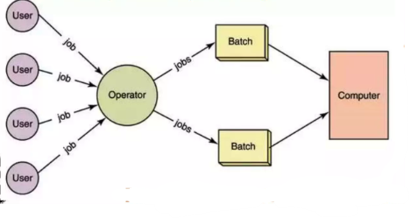
Batch Processing Operating Systems
In Batch Processing OS, jobs which are of similar type are grouped together and treated as a batch.
They were stored on the Punch card which will be submitted to the system for processing.
The system will then perform all the required operations in a sequence. This is also called as Serial processing.

Slide 38
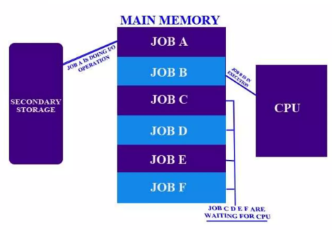
Multiprogramming OS
Multiprogramming is also the ability of an operating system to execute more than one program on a single processor machine. More than one task/program/ job/process can reside into the main memory at one point of time.

Slide 39
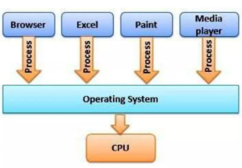
Multitasking OS
Multitasking is a logical extension of a multiprogramming system that supports multiple programs to run concurrently. In a multitasking operating system, more than one task is executed at the same time. In this technique, multiple tasks, also known as processes, share common processing resources such as a CPU.
Example: Almost all of today's operating systems like Microsoft Windows, and Linux can do multitasking. When you open your Web browser and then open Excel, paint and Media player at the same time, you are causing the operating system to multitasking.

Slide 40
Multiprogramming: This is about keeping multiple programs in the computer's memory at once. The operating system switches between them to make it seem like they are all running at the same time. However, with multiprogramming, only one program is actively using the CPU at any given moment; the others are just waiting their turn.
Multitasking: This is a more advanced form of multiprogramming. In multitasking, the operating system allows multiple tasks to be executed simultaneously by using the CPU efficiently. It manages these tasks in such a way that they can run concurrently, sharing the CPU’s processing power, which makes it feel like everything is happening at once.

Slide 41
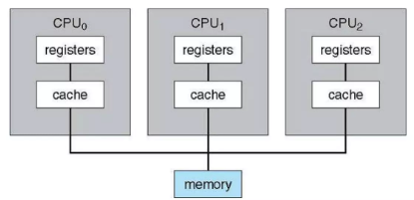
Multiprocessor OS
Multiprocessor Operating System Multiprocessor Operating System refers to the use of two or more central processing units (CPU) within a single computer system. These multiple CPUs are in a close communication sharing the computer bus, memory and other peripheral devices.

Slide 42
Timesharing OS:
Allows multiple users to share system resources efficiently.
It allocates a small amount of processing time (called a "time slice") to each user or task, rapidly switching between them. This creates the illusion that all users are interacting with the system simultaneously.
Examples: Unix, Multics.
Real-Time OS (RTOS):
Designed to handle events or data in real-time with predictable response times.
Prioritizes tasks based on time constraints, ensuring critical tasks are completed within a certain time frame (either "hard" real-time or "soft" real-time).
Examples: VxWorks, FreeRTOS.

Slide 43
Distributed OS:
Manages a group of independent computers and makes them appear as a single system to users.
It allows systems on different machines to communicate and share resources seamlessly.
Examples: Microsoft Azure, Google’s File System (GFS).
Embedded OS:
Used in embedded systems, these are specialized OSes designed to operate within a specific hardware configuration.
Highly optimized for specific tasks, often with limited memory and computing power.
Examples: Embedded Linux, Windows Embedded.

Slide 44
Parallel Processing OS:
Designed to run programs by dividing tasks between multiple processors working concurrently.
Coordinates processing across multiple CPUs to speed up execution of tasks, often for complex computations.
Examples: IBM’s AIX, Cray’s UNICOS.
Mobile OS:
Developed specifically for mobile devices like smartphones and tablets.
Optimized for touchscreen interfaces and mobile communication, while managing power consumption efficiently.
Examples: Android, iOS.

Slide 45
OS Tutorial Interacting with OS

Slide 46
What is a CLI?
A command line interface (CLI) is a software mechanism you use to interact with your operating system using your keyboard. Another mechanism is a graphical UI (GUI), which is popular today with all applications and software systems.
You can use a GUI to visually navigate and click on icons and images to make things work. However, a GUI is inefficient for system administration tasks, especially if the environment is virtual or remote.
With a command line interface, you can enter text commands to configure, navigate, or run programs on any server or computer system. All operating systems—including Linux, macOS, and Windows—provide a CLI for faster system interaction.

Slide 47
What are the use cases of a CLI?
System administration
System administrators use CLIs to fix system-related issues, check the operating system configurations, and change or update configurations on remote machines. They can run commands and control systems at scale.
Software development
Software developers regularly use CLI tools to save time and streamline their workflows. For instance, they frequently access third-party libraries while working. If they add references to these libraries using a CLI, they can do so with one inserted command instead of leaving instructions to search for the library using the GUI. This approach saves time for both the developer and future users that interact with the system.
Cloud computing
In cloud environments, a CLI is essential for managing virtual machines, containers, cloud services, and server configurations. Developers and administrators use CLIs to interact with cloud providers' APIs, automate resource provisioning, and deploy applications.
Network management
Network administrators use CLIs to configure routers, switches, firewalls, and other networking devices. CLI tools help when you want to monitor network traffic, troubleshoot connectivity issues, and implement security policies. Penetration testers also use command line tools for vulnerability scanning, network reconnaissance, and incident analysis.

Slide 48
How does a CLI work?
A command line interface (CLI) is a text-based interface where you can input commands that interact with a computer’s operating system. The CLI operates with the help of the default shell, which is between the operating system and the user.
CLI shell
A shell refers to a program that is an intermediary between the user and the operating system. Examples include Bash, cmd.exe, PowerShell, and others for more specific functions.
The shell is responsible for handling various tasks such as command parsing, environment management, and process execution. Shells also support features like these:
Command history, where you can access previously entered commands using arrow keys or other shortcuts
Input and output redirection
Piping—where you connect the output of one command as the input of another—and environment variable management
Additionally, you can customize your shell environment. To do this, you can set environment variables, define aliases (shortcuts for longer commands), and create shell scripts for automation or repeated tasks.

Slide 49
How commands work
When you enter a command in the CLI, the following steps occur:
The shell command line interpreter parses the entered command to understand its structure and separate the command name, options, and arguments.
The shell looks up the command name in its list of available commands. The command name represents the action the user wants the operating system to perform.
It searches the system's PATH variable (a list of directories where system files are located) to find the corresponding file associated with the command.
The CLI shell calls the appropriate file passing any specified options and arguments as input.
The operating system performs the required actions.
It may produce output, such as informational messages, error messages, the requested data, or result of the operation.
The CLI shell displays the output, so you can see the outcome of the command.
The CLI shell operates in a loop, waiting for you to enter another command. The process of command entry, parsing, execution, and output display repeats as you interact with the CLI shell. This provides a continuous interface for command-based interactions.

Slide 50
Basic Ubuntu Commands
ls – List Directory Contents
cd – Change Directory
pwd – Print Working Directory
mkdir – Make Directory
rm – Remove
cp – Copy
mv – Move
touch – Create Empty File
cat – Concatenate and Display
nano – Text Editor
grep – Search "Global Regular Expression Print."
sudo – Superuser Do
apt-get – Package Manager
dpkg – Package Manager
chmod – Change Mode
chown – Change Owner
tar – Tape Archive
uname – Print System Information
date – Display Date and Time
shutdown – Shutdown or Restart System
ps – Process Status
top – Display System Activity
du – Disk Usage
df – Disk Free

Slide 51
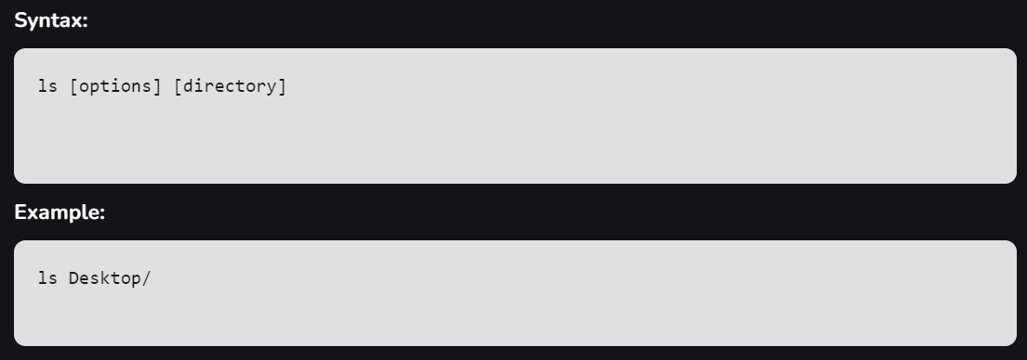
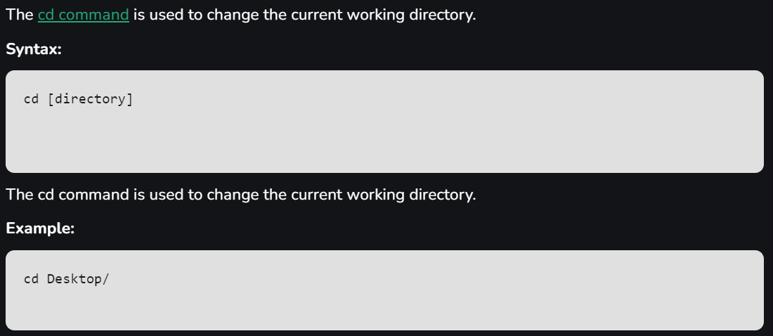

Slide 52
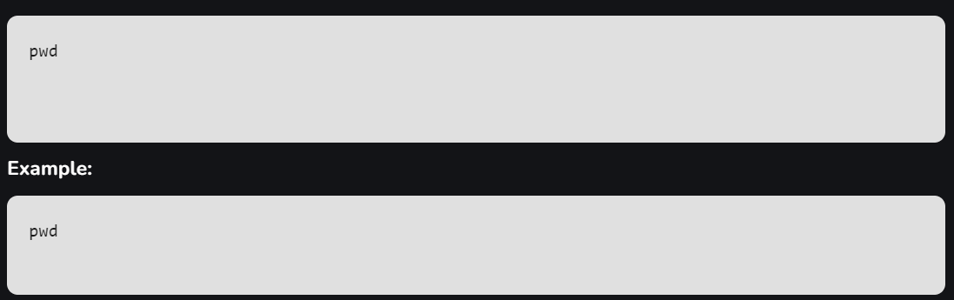
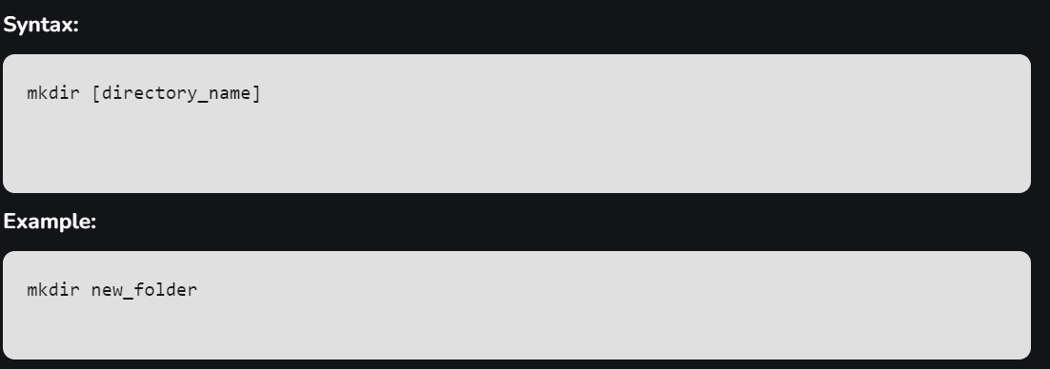

Slide 53
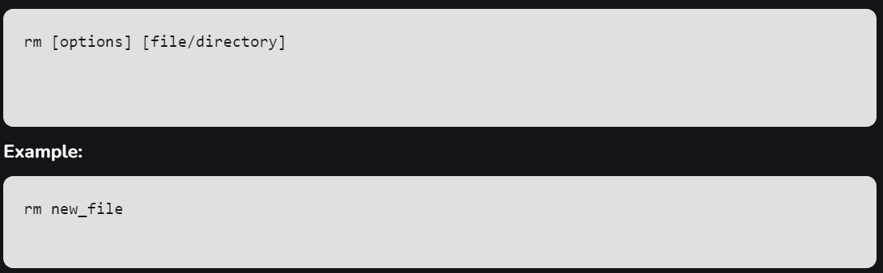
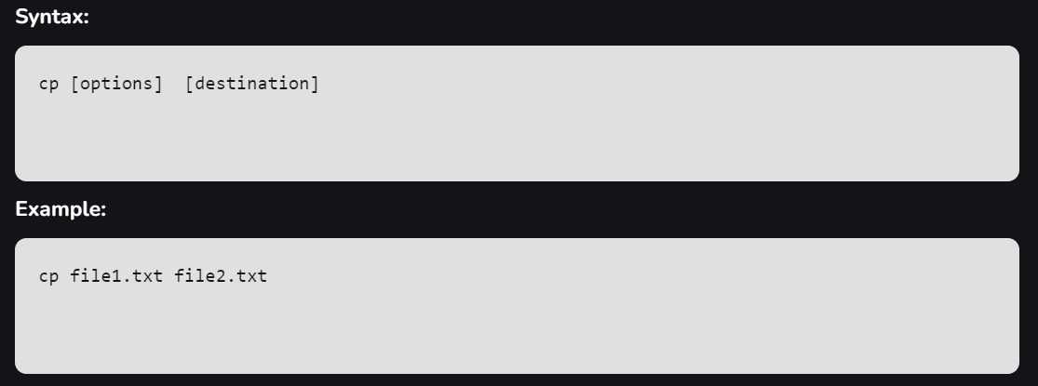

Slide 54
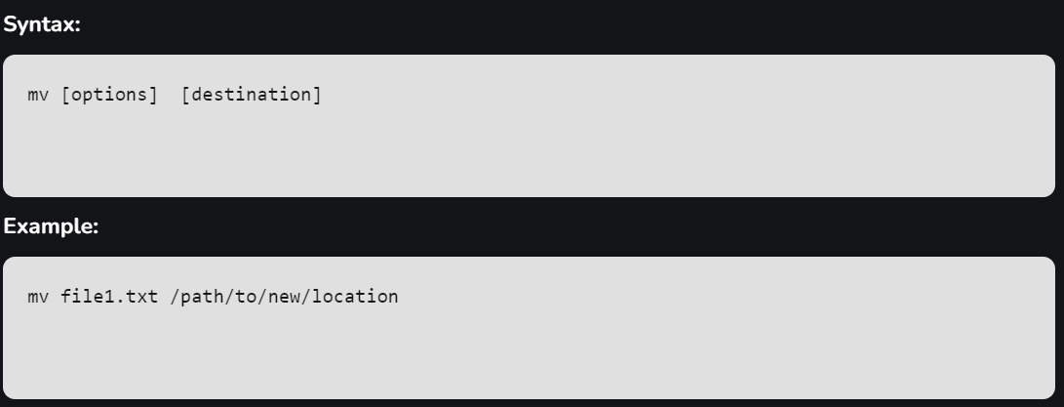
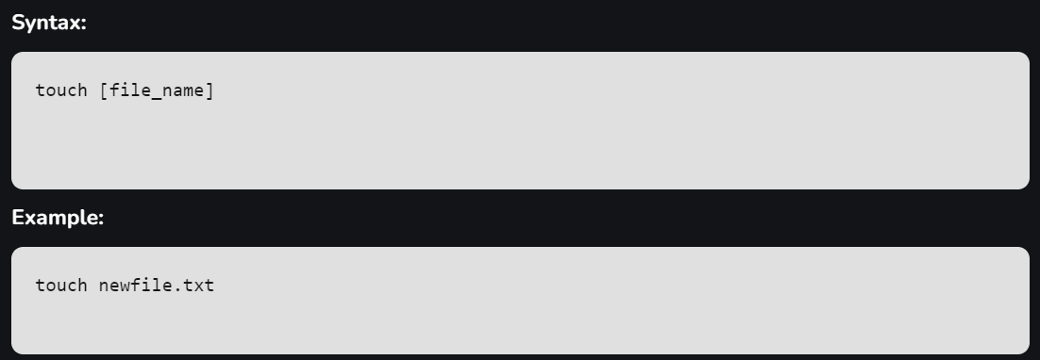

Slide 55
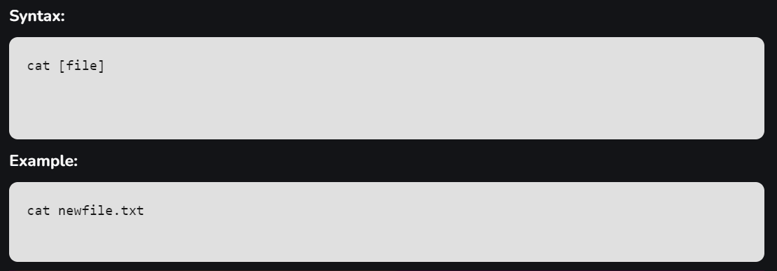
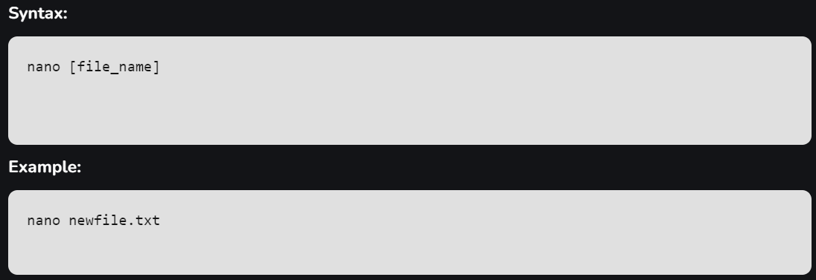

Slide 56
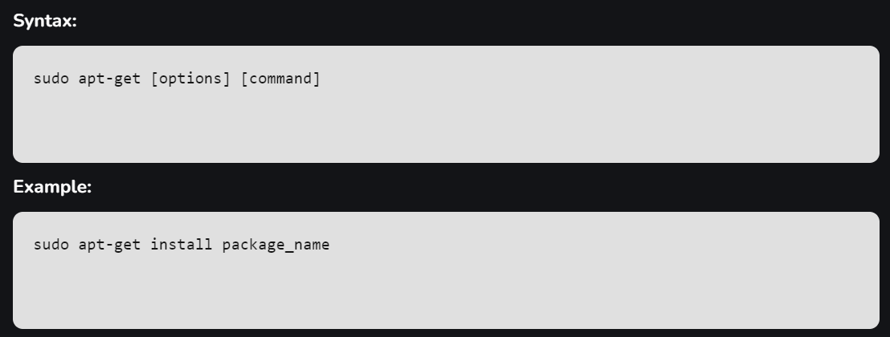
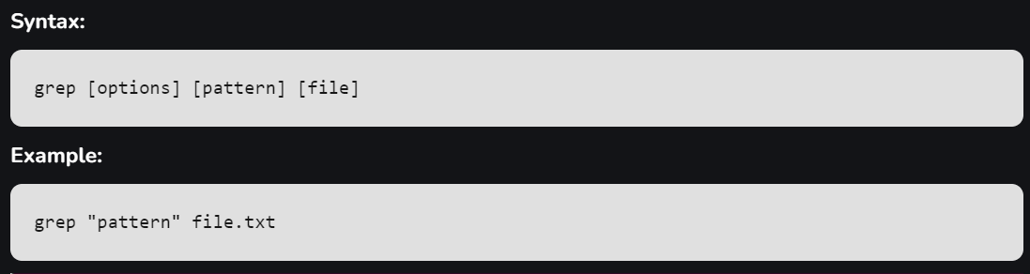
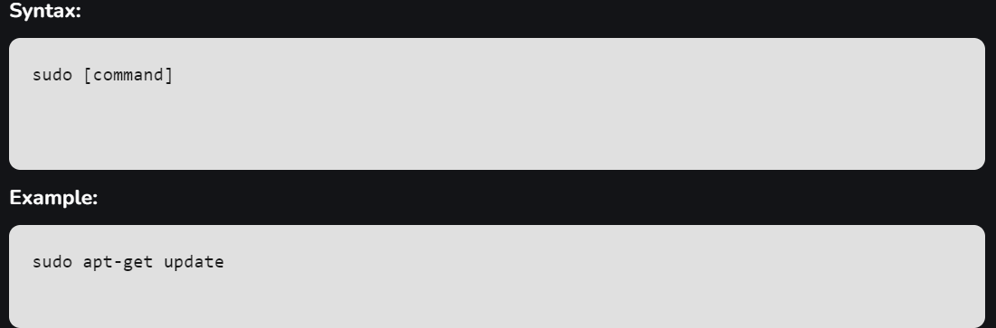
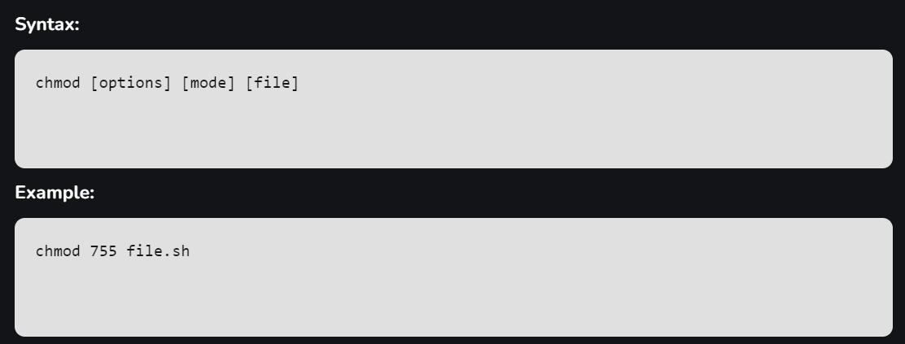
Common Options for Grep
-i: Ignore case (case-insensitive search).
-v: Invert the match, showing lines that do NOT match the pattern.
-r or -R: Recursively search through directories.
-n: Show line numbers of matching lines.
-c: Count the number of matching lines.
-l: List only the names of files with matching lines.
-e: Specify multiple patterns.

Slide 57
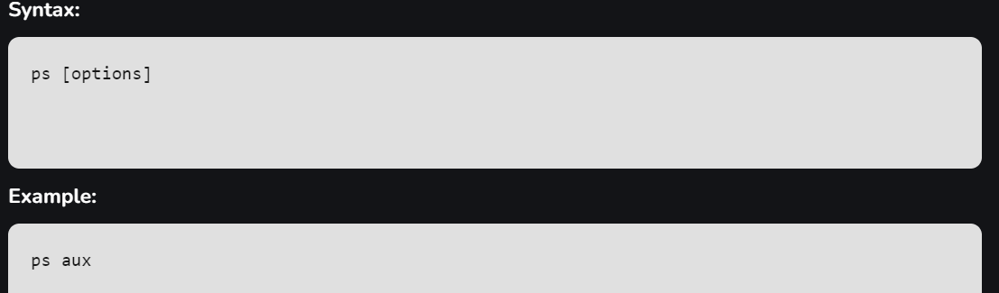
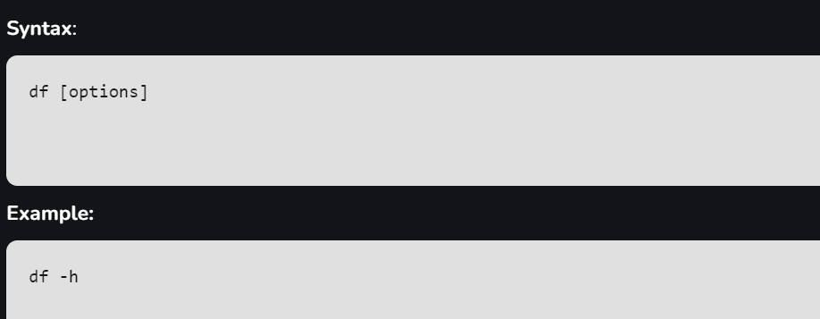
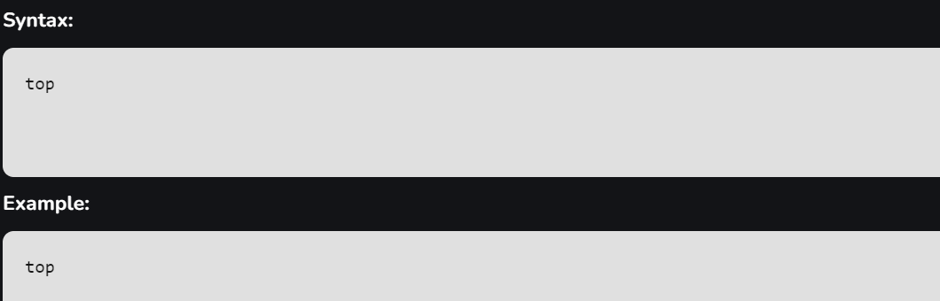
df (disk free) command displays information about the file system’s disk space usage, showing how much space is available and used on mounted filesystems.
Common Options:
-h: Display sizes in a human-readable format (e.g., KB, MB).
-T: Show the type of filesystem.
-a: Include pseudo, duplicate, and inaccessible file systems.
ps command displays information about running processes.
Common Options:
-e: Show all processes.
-f: Show full format listing.
-u: Display processes for a specific user.
aux: Display all processes with detailed information.

Slide 58
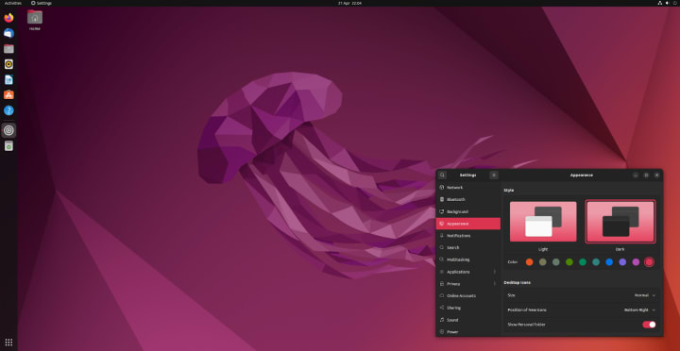
Screen Interaction

Slide 59
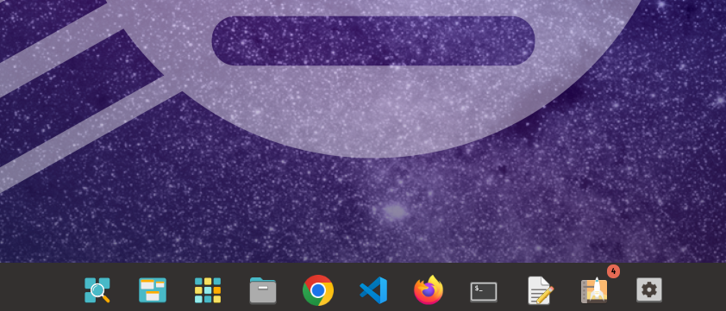

Terminal

Slide 60
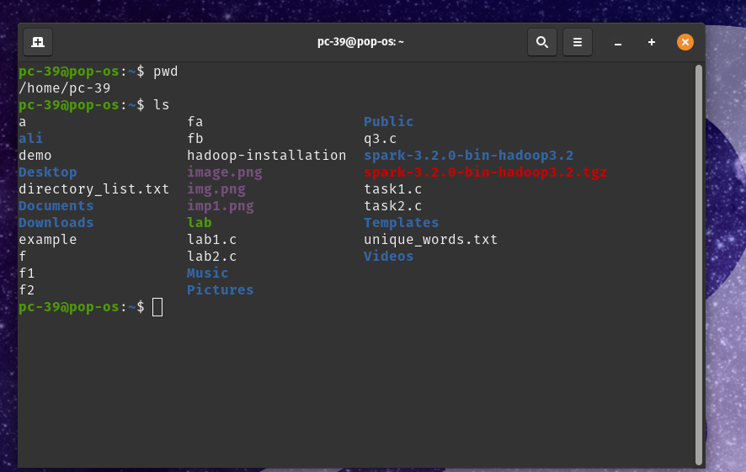

Slide 61
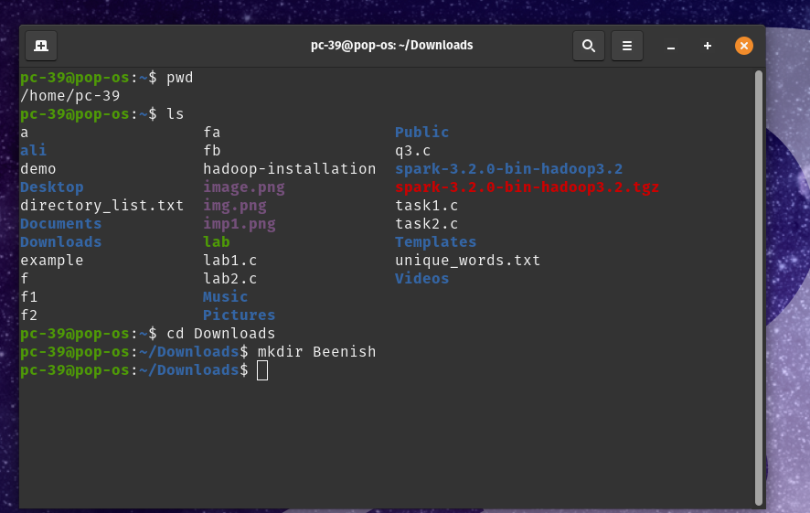

Slide 62
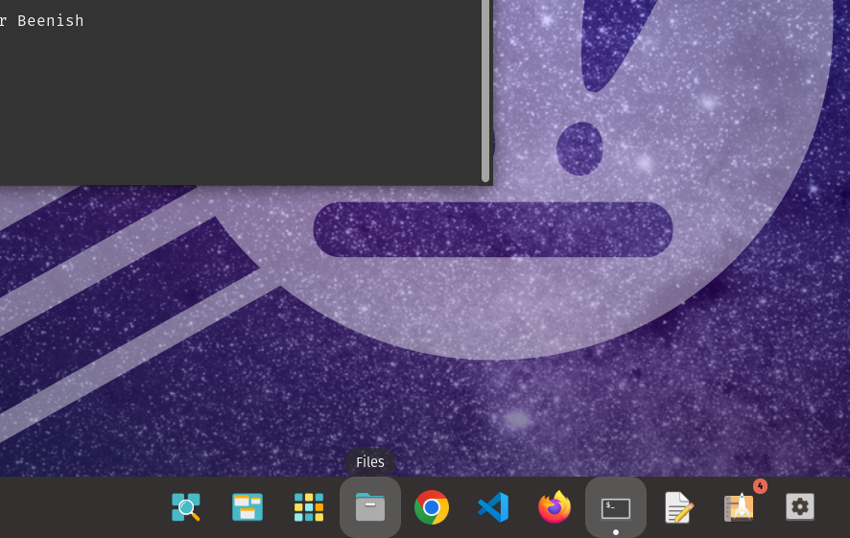


Slide 63
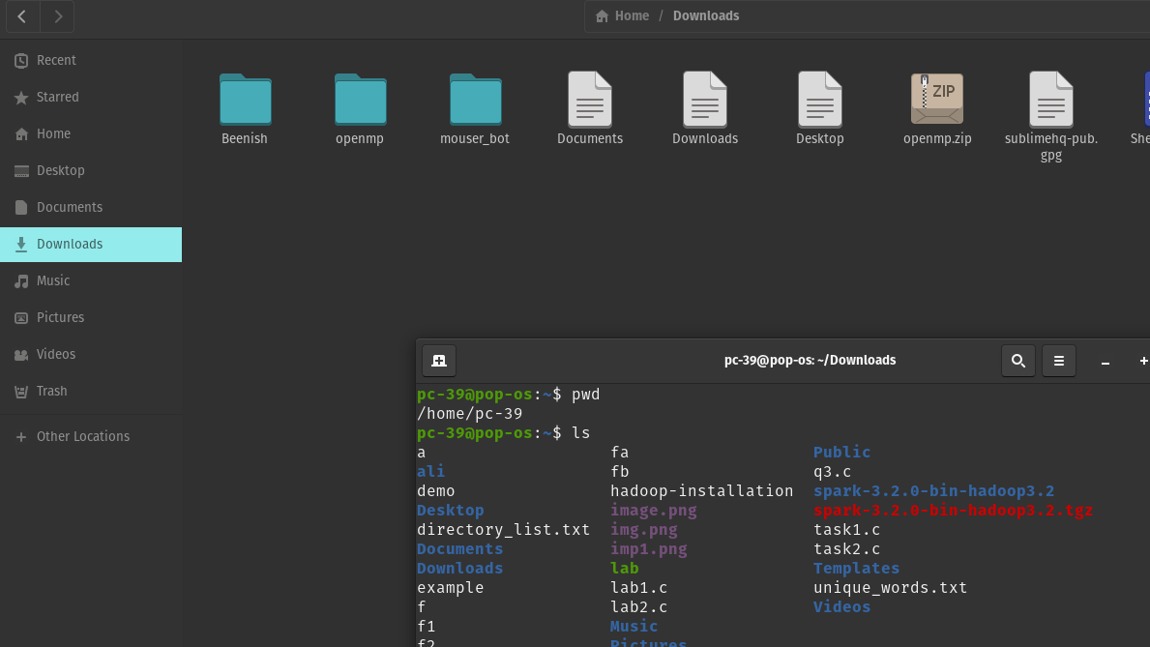

Slide 64
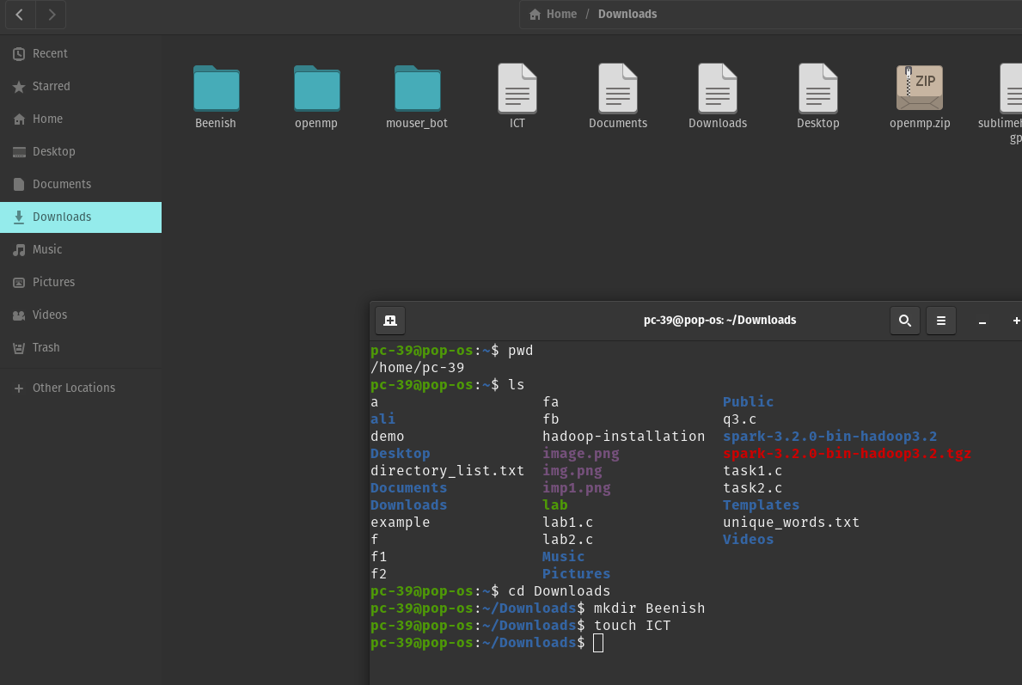

Slide 65
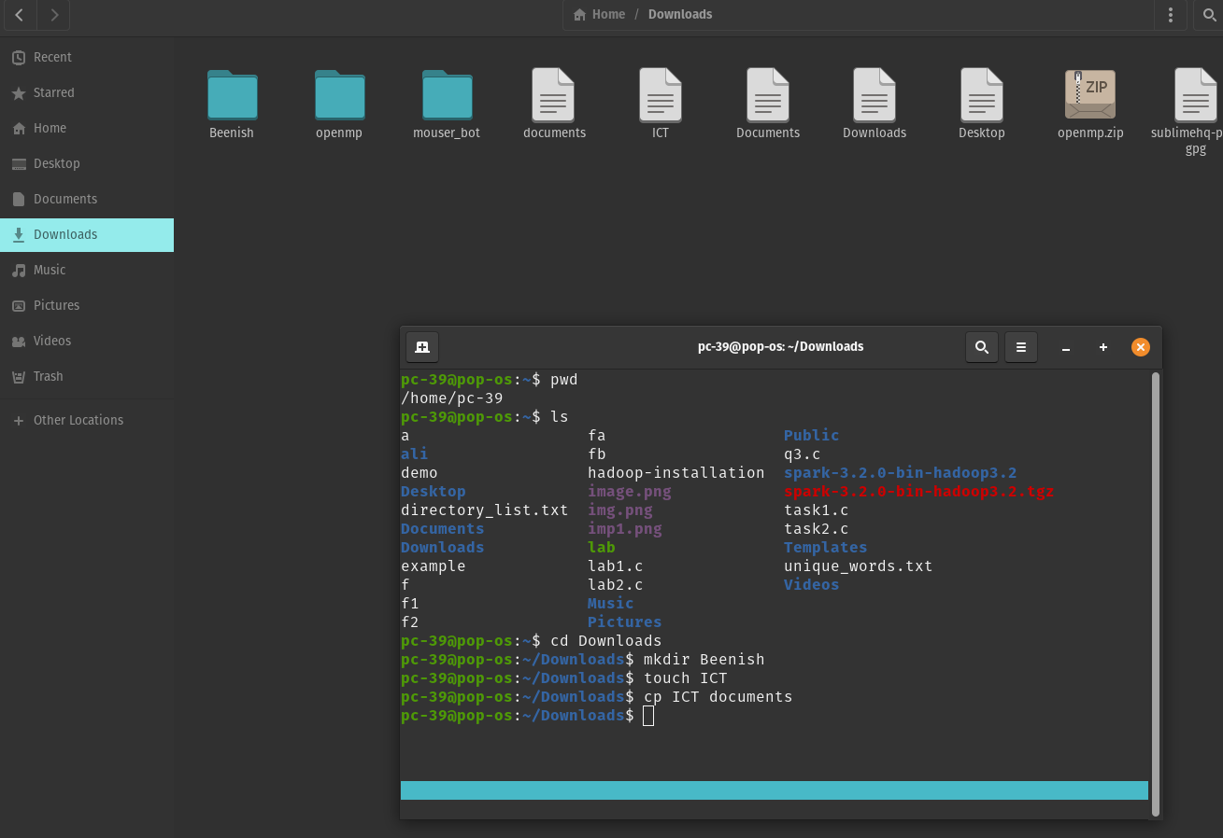

Slide 66
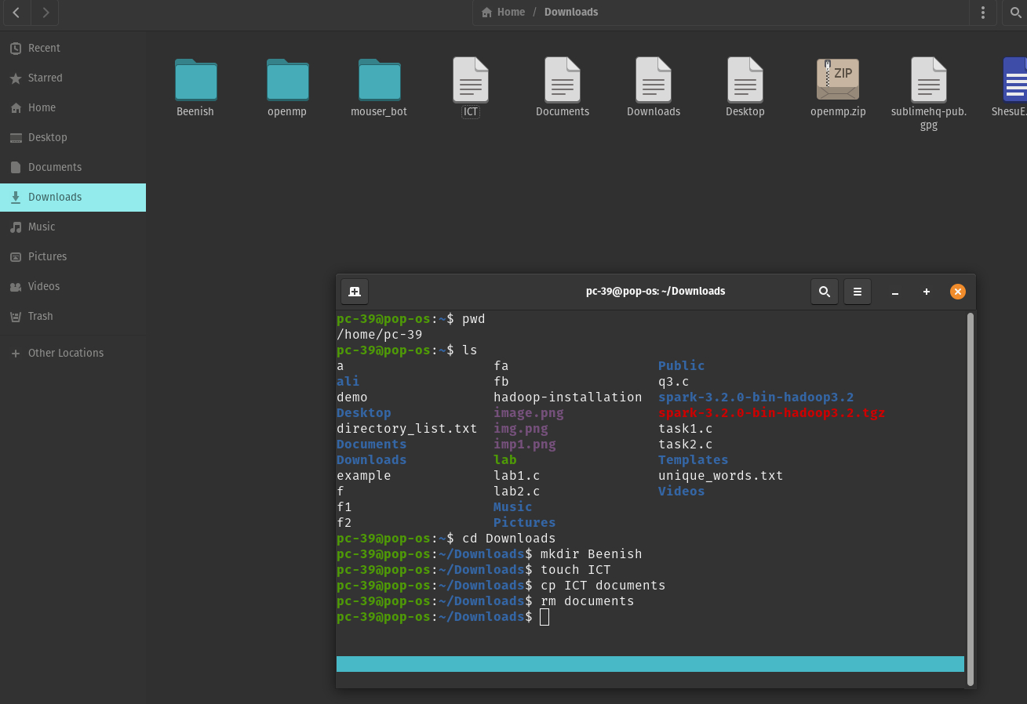

Slide 67
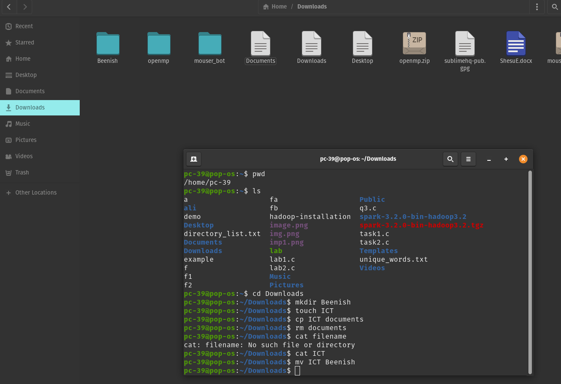

Slide 68
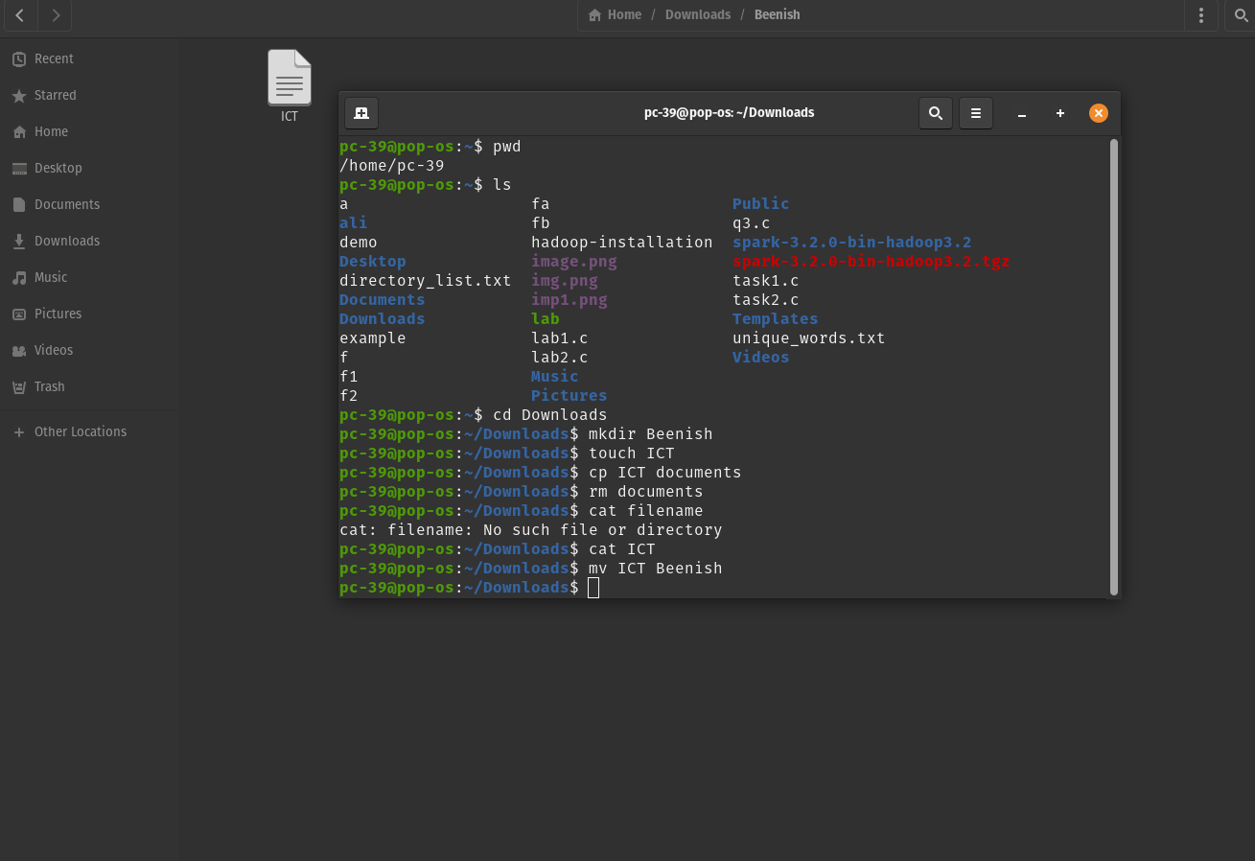

Slide 69
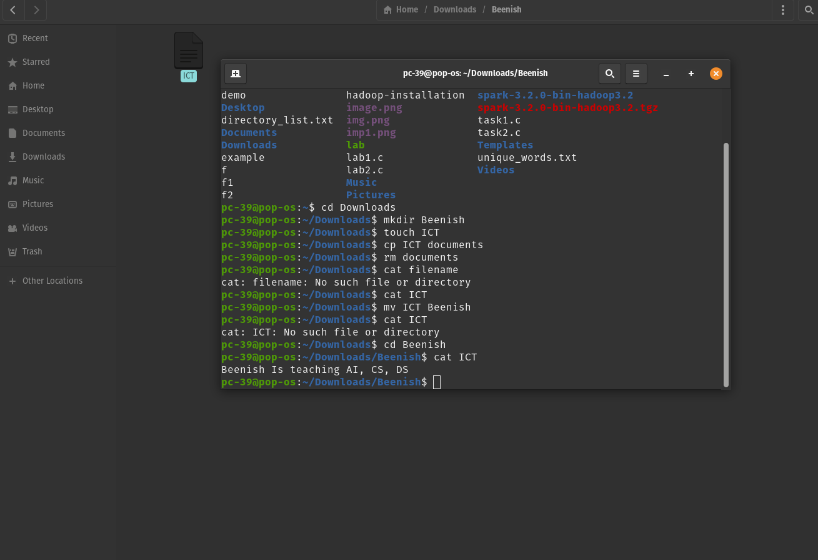

Slide 70


Slide 71


Slide 72


Slide 73


Slide 74


Slide 75
Small Project (Assignment Task)
Beginner-Level Project: Linux System Health Monitoring Script
This project involves creating a Linux health monitoring script using the basic Linux commands that will help monitor the system's disk space, memory usage, CPU load, running processes, and network connectivity. The script will output an easy-to-read report, which will provide an overview of the system's health.

Slide 76

Open your terminal and create a new script file called system_health.sh:

Slide 77

Ctrl X , Ctrl Y to confirm changes or press Ctrl S then X.

Slide 78


